Slide 1
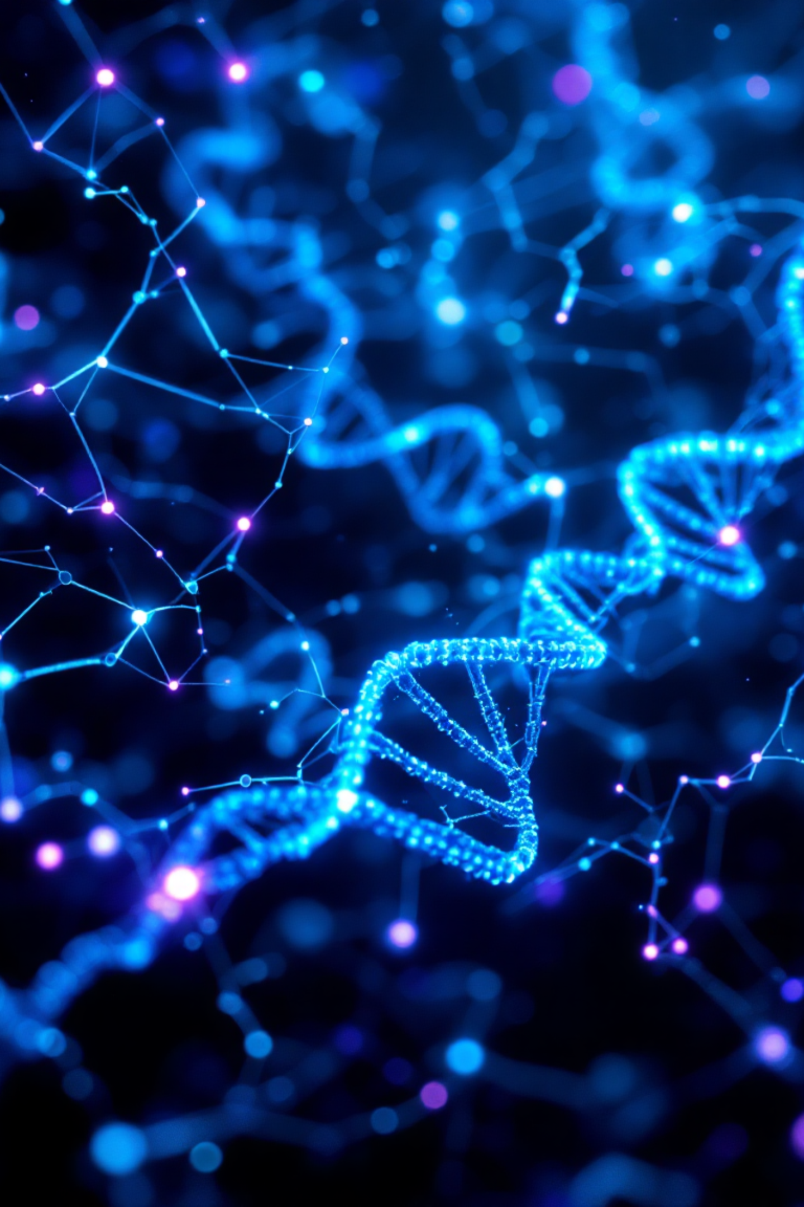
The AI Revolution in Biomedicine
Artificial intelligence is fundamentally transforming how we discover treatments, diagnose diseases, and deliver personalized care—ushering in a new era of precision medicine.

Slide 2
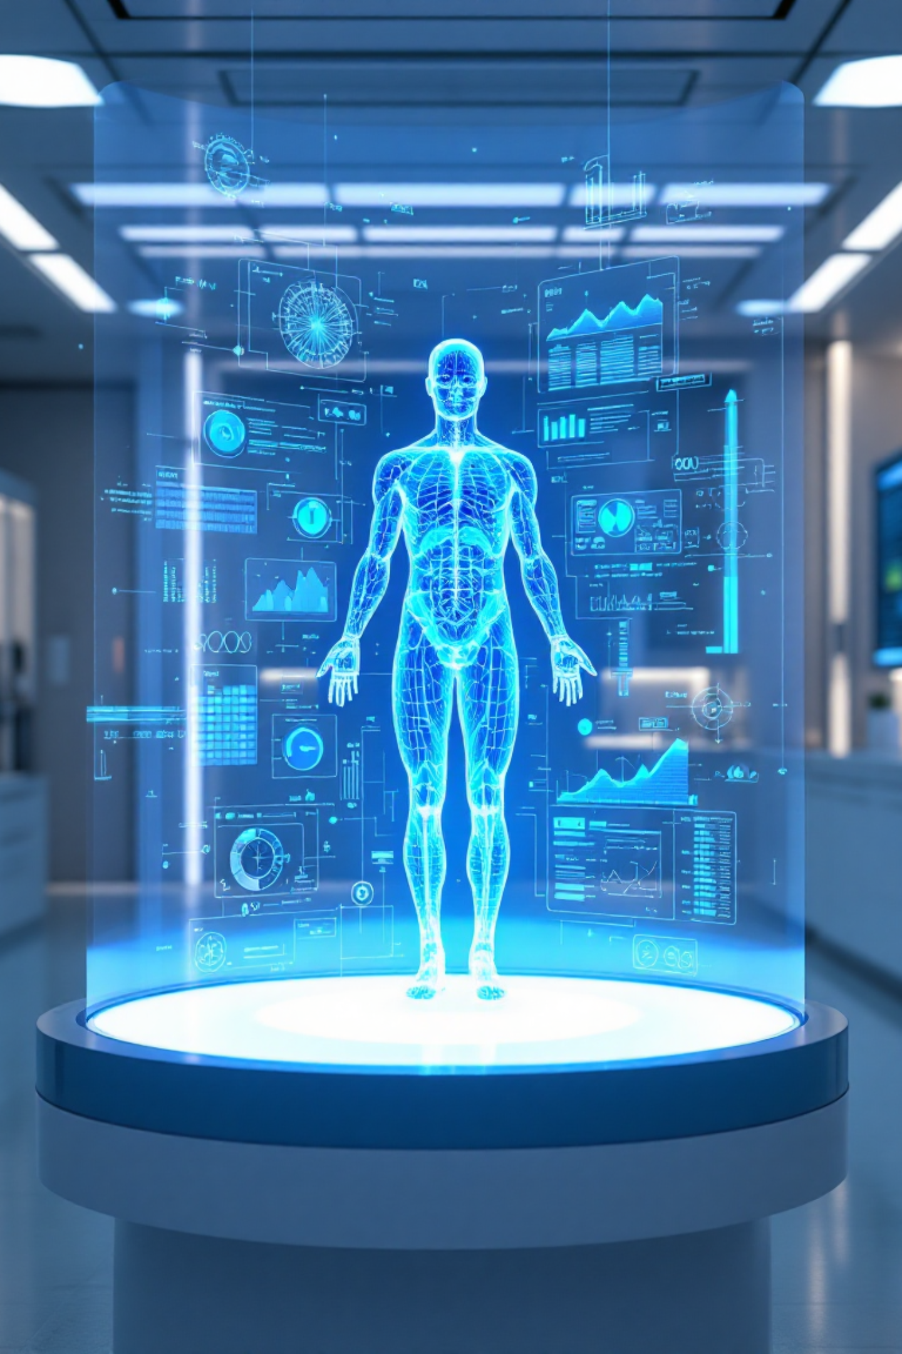

Transforming Healthcare Across Three Frontiers
AI-Driven Drug Discovery
Intelligent Diagnostic Imaging
Machine learning algorithms analyze millions of molecular compounds in days instead of years, identifying promising drug candidates and predicting efficacy with unprecedented speed and accuracy.
Deep learning models detect tumors, fractures, and anomalies in medical scans with superhuman precision—catching diseases earlier and enabling faster, more confident clinical decisions.
Personalized Treatment Plans
AI integrates genetic data, lifestyle factors, and medical history to create tailored therapies for each patient—maximizing treatment effectiveness while minimizing adverse reactions.

Slide 3
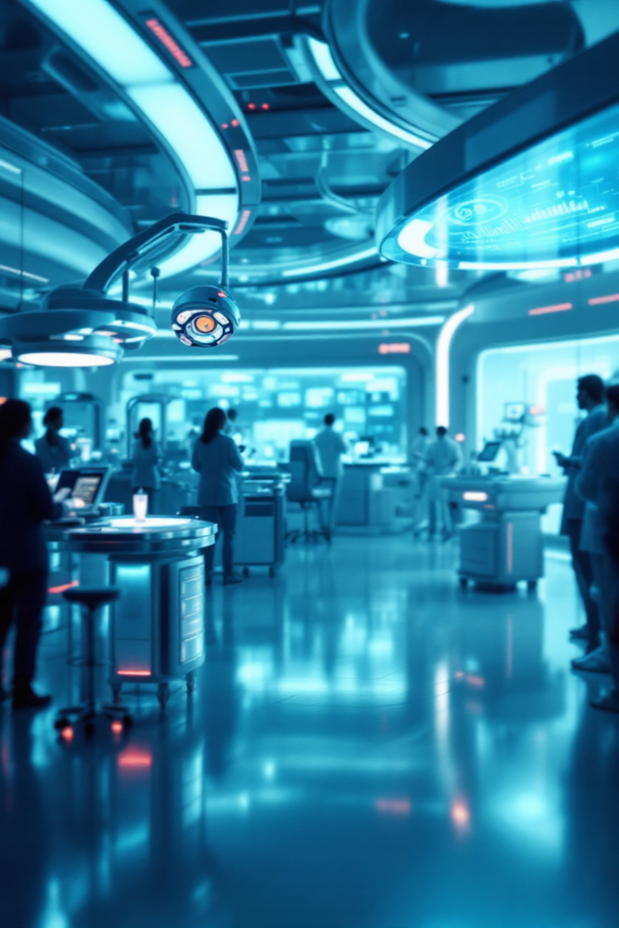
A Bold Vision for Tomorrow's Medicine
The convergence of artificial intelligence and biomedicine is not just improving healthcare—it's reimagining what's possible. From accelerating breakthrough therapies to democratizing access to world-class diagnostics, AI is poised to save millions of lives.
10x
Faster Drug Development
The future is here: predictive medicine that prevents disease before symptoms appear, treatments designed at the molecular level for individual patients, and healthcare systems that learn and improve with every interaction.
95%
Diagnostic Accuracy
As AI continues to evolve, the boundaries between technology and biology will blur—creating opportunities we've only begun to imagine.
40%
Cost Reduction

